Slide 1
CT Project Weekly Status Report
Jack Xu, Jenny Jiang

Slide 2
Plan for this week
Finish Analysis of solutions including Google and apple
Analyze UI/UX design of other solutions
Define features in a more specific way
Present the analysis of solutions and features of App
Our work this week
Made an in-depth research of Google/Apple API
//TODO
Defined features CT Application is going to produce and made a design doc.

Slide 3
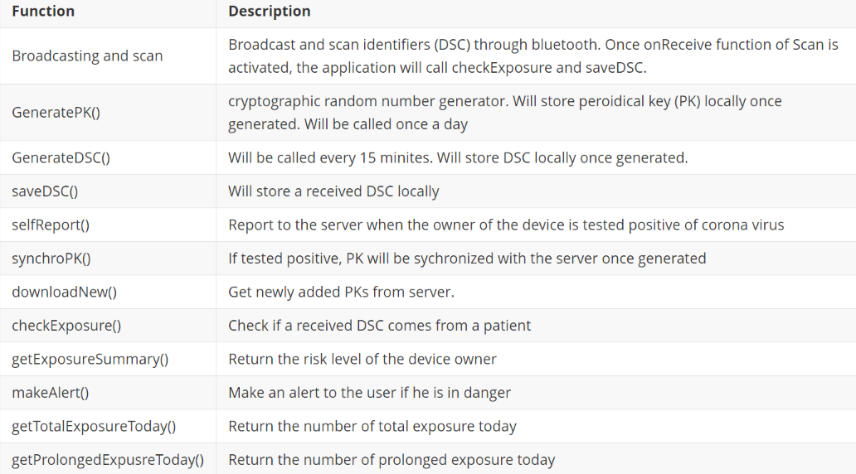
Our work this week
UI Design and Functions to be Implemented
UI Design Here

Slide 4
Plans for next week
Starting coding
//TODO

